Slide 1
Authentication of banknote using machine learning algorithms
Presented by- Rachana Jadhav (1503029)
Vishakha Kesarkar (1503030)
Shahida Momin (1503034)

Slide 2
Analysis on Banknote
There has been a drastic increase in the rate of fake notes in the market. Fake money is an imitation of the genuine notes and is created illegally for various motives.
It is difficult for human-eye to recognize a fake note because they are created with great accuracy to look alike a genuine note.
Security aspects of banknotes have to be considered and security features are to be introduced to mitigate fake currency. Hence, there is a dire need in banks and ATM machines to implement a system that classifies a note as genuine or fake

Slide 3
Support vector machine
SVM or Support Vector Machine is a linear model for classification and regression problems. It can solve linear and non-linear problems and work well for many practical problems.
The idea of SVM is simple: the algorithm takes the data as an input and gives output by creating a line or a hyperplane which separates the data into classes.

Slide 4
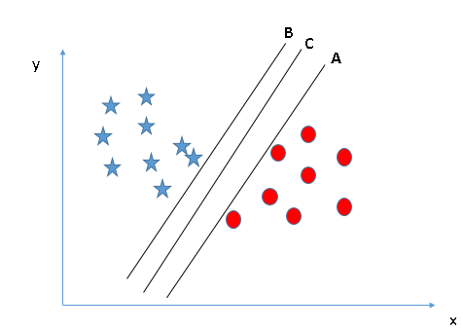
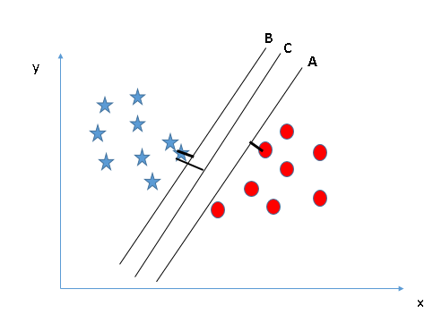
Support Vector Machines are based on the concept of decision planes that define decision boundaries. A decision plane is one that separates between a set of objects having different class memberships. A schematic example is shown in the illustration below.

Slide 5
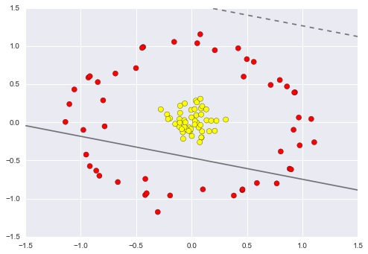
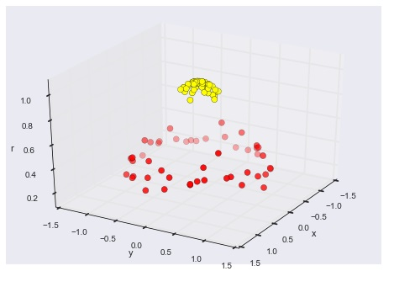
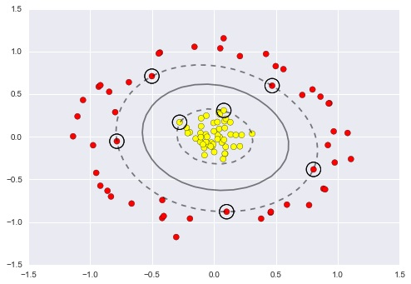

Slide 6
Random forest algorithm
Random forests is a supervised learning algorithm. It can be used both for classification and regression. It is also the most flexible and easy to use algorithm.
Random forests creates decision trees on randomly selected data samples, gets prediction from each tree and selects the best solution by means of voting.
Random forests has a variety of applications, such as recommendation engines, image classification and feature selection. It can be used to classify loyal loan applicants, identify fraudulent activity and predict diseases.

Slide 7
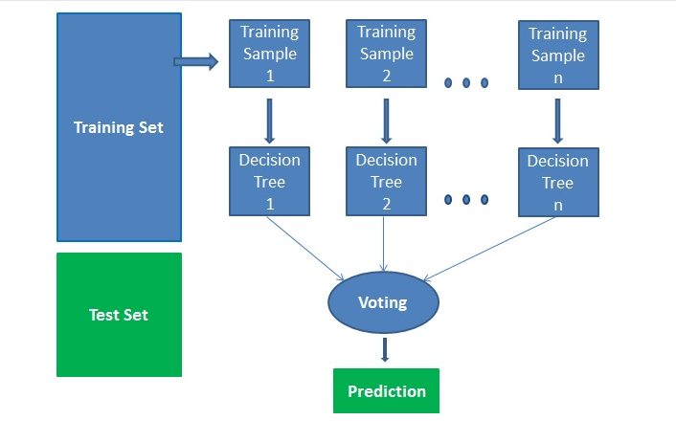
How algorithm works ?
Pick N random records from the dataset.
Build a decision tree based on these N records.
Choose the number of trees you want in your algorithm and repeat steps 1 and 2.
In case of a regression problem, for a new record, each tree in the forest predicts a value for Y (output). The final value can be calculated by taking the average of all the values predicted by all the trees in forest.
Or, in case of a classification problem, each tree in the forest predicts the category to which the new record belongs. Finally, the new record is assigned to the category that wins the majority vote.

Slide 8
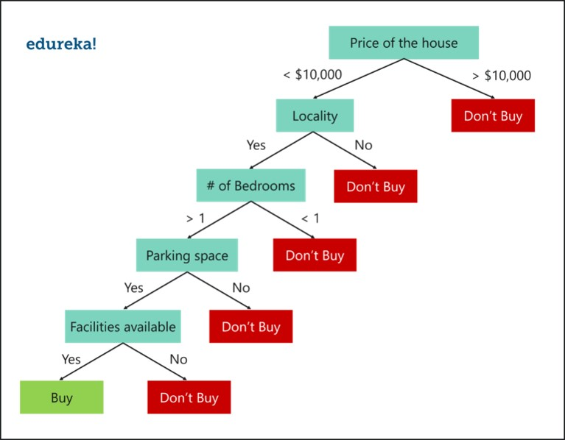
Lets take an example, suppose you’re looking to buy a house, but you’re unable to decide which one to buy. So, you consult a few agents and they give you a list of parameters that you should consider before buying a house.
Using Decision tree alogorithm

Slide 9
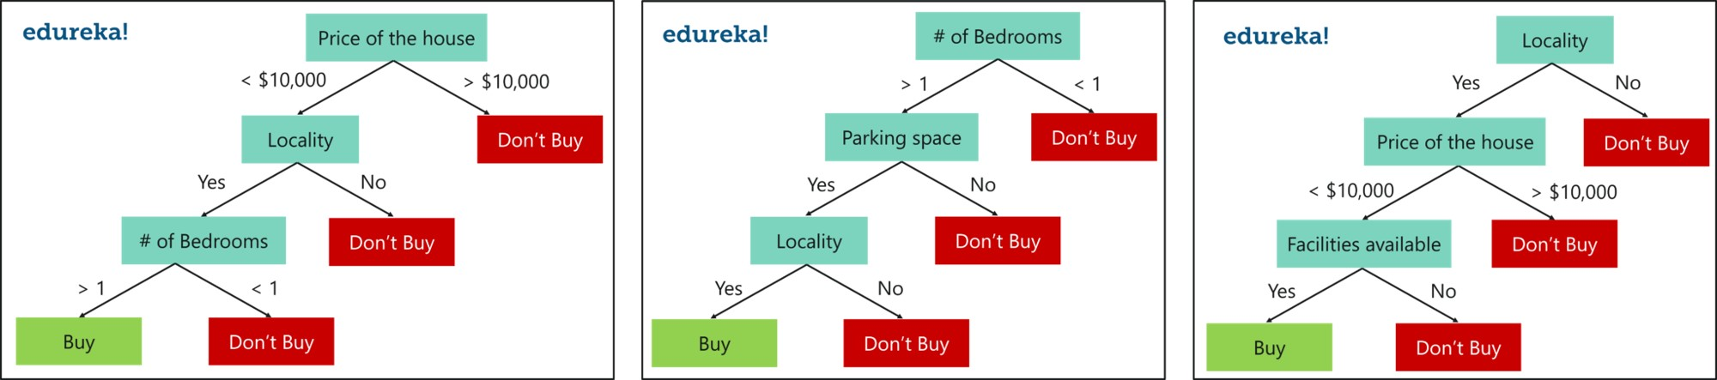
Using Random Forest Algorithm

Slide 10
advantages
It can be used for both regression and classification tasks .
Very handy and easy to use algorithm, because it’s default hyperparameters often produce a good prediction result.
Individual decision trees can be trained in parallel
Random forests are widely used
For applications in classification problems, Random Forest algorithm will avoid the overfitting problem.

Slide 11
Thank you

